Slide 1

KEYLOGGER
P. Priyadarshini B.TECH-IT
Aalim Muhammed Salegh College of Engineering.

Slide 2

PROBLEM STATEMENT
Keylogger Functionality
Security Concerns
A keylogger silently records all keystrokes, creating a log of everything typed.
Keyloggers can lead to privacy breaches and expose sensitive information.
Effectiveness of Encryption
Assessing the effectiveness of encryption methods to secure keylogging data.

Slide 3
Proposed System/Solution :
Data Collection: Gathering information from various sources.
Data preprocessing: Cleaning and organizing the collected data.
Machine Learning Algorithm: Implementing ML for analysis and prediction.
Deployment: Rolling out the system for practical use.
Evaluation: Assessing the system's performance and effectiveness.

Slide 4

System Development Approach
1
Python IDLE
Python IDLE is an Integrated Development and Learning Environment for Python, which provides tools for writing and executing Python code.
2
pynput
pynput is a Python library used to control and monitor input devices like the keyboard and mouse.
3
jsonlib
jsonlib is a lightweight library for parsing JSON data in Python, supporting encoding and decoding of JSON objects.

Slide 5
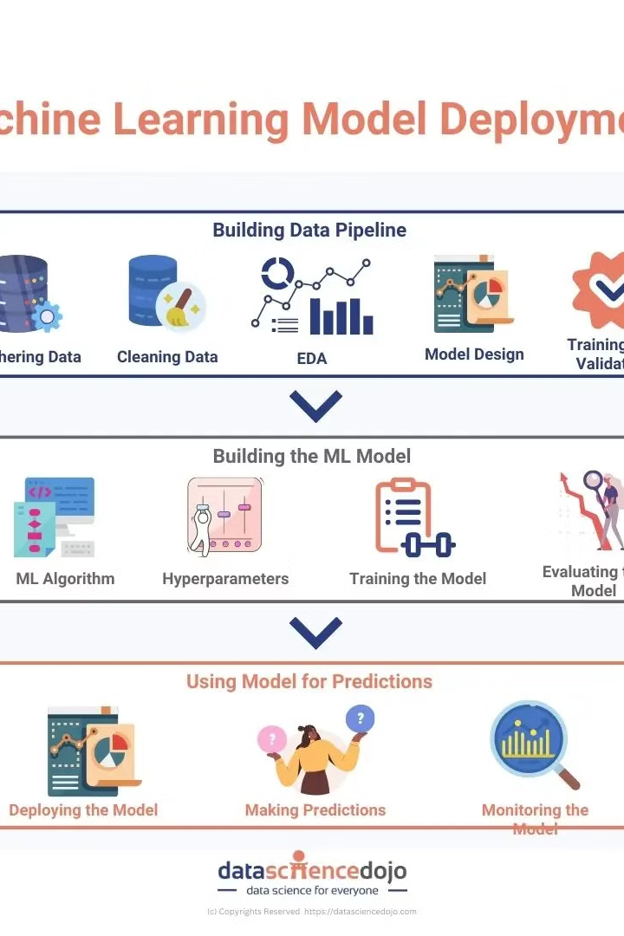
Algorithm & Deployment
After developing the machine learning algorithm, the next step is the deployment phase, where the system will be ready for practical use.
During deployment, the algorithm will be integrated and implemented within the targeted environment to ensure smooth functionality and performance.

Slide 6
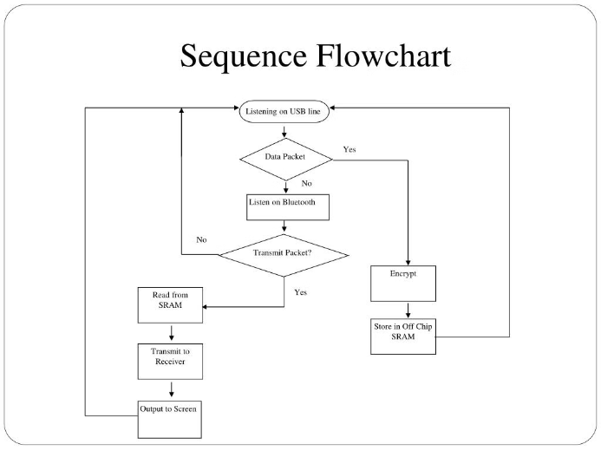
Flow chart for Keyloggers
A flow chart visualizes the sequence of steps and decisions in a keylogger system. It outlines the data capture, storage, and communication processes.

Slide 7

Result (output)
1
Text Capturing
2
Example Output
The program captures all keystrokes entered in the system.
r''a''i''n''a'Key.enterKey.backspace'm''e''s''s''i'Key.enterKey.backspaceKey.backspaceKey.backspaceKey.backspaceKey.backspace't''t''v''k'Key.enterKey.backspaceKey.backspaceKey.backspaceKey.backspace

Slide 8

Conclusion
The implementation of a keylogger provides valuable insights into keystroke activities, enhancing security measures by analyzing user inputs. This program can be useful for various security-related applications, making it a versatile tool for surveillance and monitoring purposes.

Slide 9




Future Scope
Troubleshooting IT issues
Improving computer products through user feedback
Monitoring business server activity
Managing remote workforces
Observing business server activity to ensure smooth operations. Utilizing user feedback to enhance computer products. Troubleshooting IT concerns for seamless functionality. Management of remote workforces for efficient collaboration.
Also, vigilantly monitoring productivity while ensuring robust data security.

Slide 10
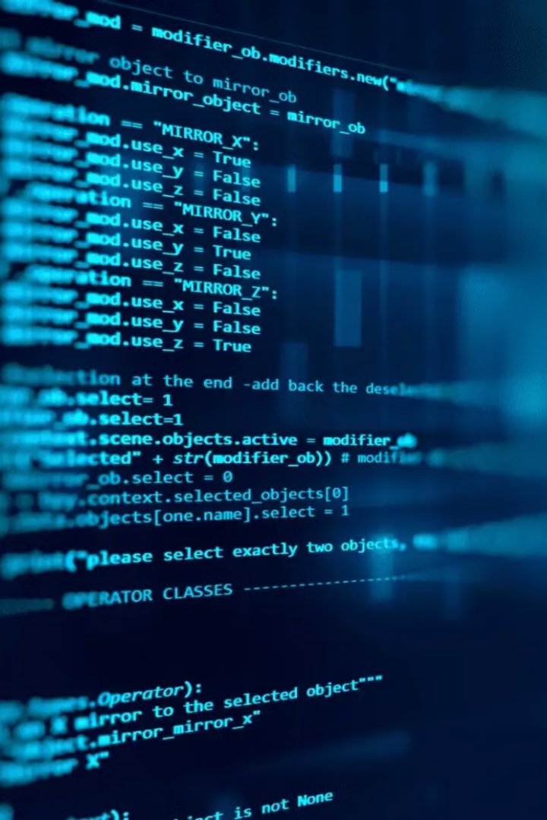
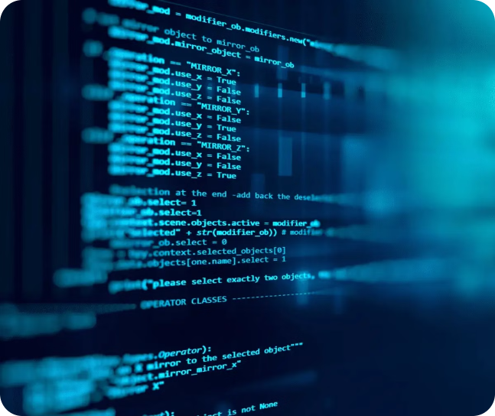
References:
For more information about keyloggers and security, you can refer to the following resources:
GitHub - Keylogger
GitHub - Python Keylogger
https://youtu.be/V5-LSvv2erk?si=1bM3voALHjO5VS21

